Slide 1

Texas Real Estate predict house prices based on various real estate features using Machine Learning Presented by: Rebecca, Natalie, Russell, Michael, Trinity
Group 3 Project 2
Aug 11, 2024

Slide 2

Executive Summary
This project aims to develop a machine learning model to predict house prices based on various real estate features. The dataset contains essential information about houses, such as the number of bedrooms and bathrooms, lot size (in acres), house size (in square feet), and geographic location (city, state, and zip code). Additionally, key variables include the previous sale date, the house's age since the last sale, and the average house value in the corresponding zip code area. This project will provide valuable insights into real estate pricing, enabling stakeholders to make informed, data-driven decisions based on housing trends across different geographical regions.
Project Approach
Data Preprocessing: Prepare and clean the data, including handling missing values, encoding categorical variables (city, state, zip code), and scaling numerical features.
Model Development: Train machine learning models on the dataset to predict house prices (either as price per square foot or total house price). Potential models include Linear Regression, Random Forest, and Gradient Boosting.
Model Evaluation: Use a variety of metrics such as Mean Absolute Error (MAE), Mean Squared Error (MSE), and R-squared (R²) to evaluate model performance and refine it for accuracy.
Feature Importance: Identify the most important factors affecting house prices, such as location, house size, or lot size, and provide insights into market trends.
Predictive Analysis: Once a final model is selected, use it to make predictions on unseen data to assess its robustness in a real-world scenario.

Slide 3
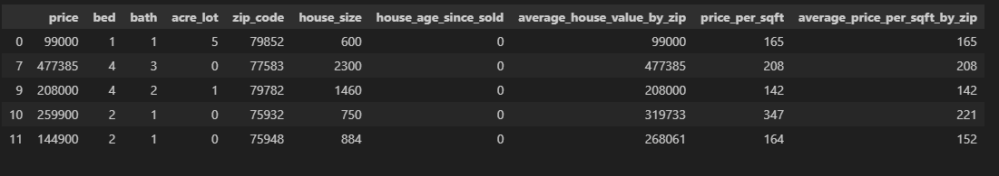

Dataset
USA Real Estate Dataset features real estate listing across the United States, categorized by State and Zip code. The original dataset, sourced from Kaggle, contained 2.2 million entries. We narrowed down the data by focusing exclusively on properties in Texas, resulting in a reduced dataset with 12 columns and 40,111 rows.
Data Exploration and Cleaning
In the data exploration phase, we thoroughly examined the dataset to understand its structure, variable types, and key statistics. We utilized visualizations like histograms and scatter plots to identify patterns, relationships, and outliers in the data.
For data cleaning, we addressed missing values, removed duplicates, and ensured correct data types for each column. We also dropped the columns we don’t need for data analysis. The cleaned dataset was then validated and prepared for further analysis or modeling.
Data Transformation
Feature Engineering:
1. Create a new features that could capture important relationships:
We calculate the age of the house since it was last sold
Calculate average house value by zip code and round to integer
Calculate average price per square foot and round to integer
Calculate average price per square foot by zip code and round to integer
Create a new column 'zip_code_prefix' for the first three characters of 'zip_code'
2. Removed and convert rows and datas
Remove rows where 'house_size' or 'price' is zero or NaN
Remove the specified columns from the DataFrame
Convert 'bed' and 'bath' to string, replacing NaN with '0'
Convert 'price' and 'house_size' to integers
Replace 'acre_lot' and 'house_age_since_sold' NaN with '0'
Convert 'zip_code' to string, replacing NaN with '00000'

Slide 4
Model Development
In this project, I developed a machine learning model using CatBoost Regressor. After loading and exploring the dataset, I cleaned the data by handling missing values and outliers, then performed data transformation and encoding to prepare the features. The dataset was split into 80% training and 20% testing to evaluate the model's performance. I trained the model using the training set, optimizing hyperparameters like iterations and learning rate, and made predictions on the test set. The model achieved an R-squared of 0.64, indicating a decent level of accuracy in predicting real estate prices.
Performance Metrics
Mean Absolute Error (MAE): 131489.37
Mean Squared Error (MSE):235536872546.40
R-squared (R²): 0.6432
The model's performance metrics indicate that, on average, the predictions are off by 131,489 units (MAE), which is a significant error given the context of the data. The Mean Squared Error (MSE) is very high at 235.5 billion, suggesting that the model makes some large prediction errors, as MSE penalizes larger errors more heavily. The R-squared (R²) value of 0.6432 means that the model explains about 64% of the variability in the target variable, which indicates a moderate level of accuracy but also shows room for improvement.

Slide 5
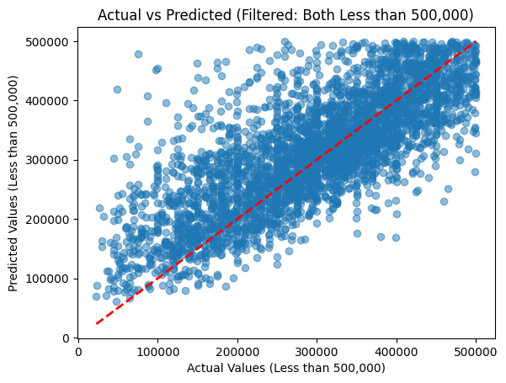
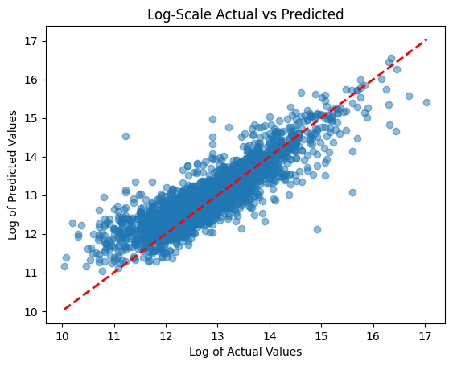
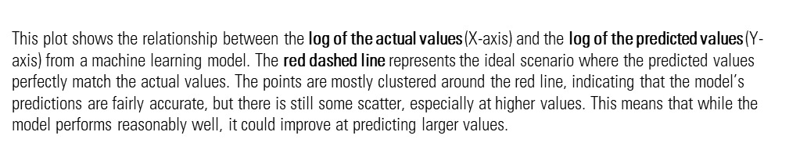
This scatter plot compares the actual and predicted values from the model, filtered to include only data points where both are less than 500,000. The red dashed line represents perfect predictions where actual equals predicted. Most points are close to this line, indicating that the model performs reasonably well in this range, though there is some spread, particularly for higher values, suggesting slight prediction errors as the actual values increase. Overall, the model is fairly accurate for predicting values under 500,000 but shows increasing variability at the higher end.

Slide 6
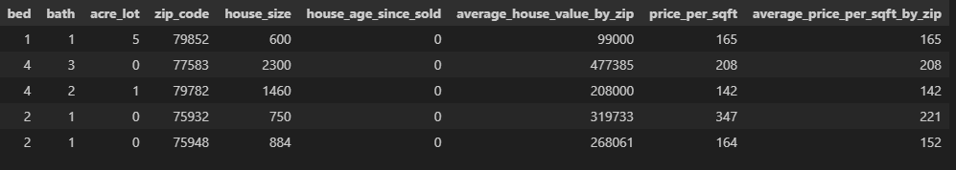
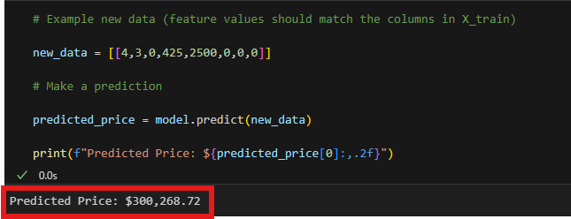
Input new data to predict the price using the trained Model

Slide 9
If given more time we want to:
Input New Data: We will create a new listing for each property, data such as the number of bedrooms, bathrooms, lot size, house size, location (city, state, zip code), and previous sale date are available.
Apply Preprocessing: Preprocess the new data as what we did with the training data, ensuring that categorical variables are encoded, and numerical features are scaled properly.
Predict House Prices: Using the final, best-performing model, we will predict the expected market price (price per square foot or total price) for each property based on the input features.
Comparison with Listed Prices: Once we have the predicted prices, will compare them with the actual listing prices of the properties. If the predicted price is significantly higher than the listing price, that property could be underpriced and a good investment opportunity.

Slide 10

THANK YOU
Links:
Dataset: Housing Market & Prices (kaggle.com)
Github Link: https://github.com/trentlerma/groupthreeproject.git
GitProject: https://github.com/trentlerma/groupthreeproject.git

